Slide 1
AGENDA
Review CLO use cases, applications, motivation for representing single cells
High level overview of common ground reached so far
Types of cultures, cells, processes to model and their relationships
The cell – culture – sample axis
Review definitions/labels for cells and cultures
Review consensus model tested in OBI
Home for classes representing cultured cells, cultures, samples, processes
Moving Ahead . . .

Slide 2
CLO Use Cases/Applications
(Oliver, Sira, Asiyah)
Who is using CLO? What kind of data is being applied to?
What is the motivation to switch to a representation of single cells rather than lines?

Slide 3
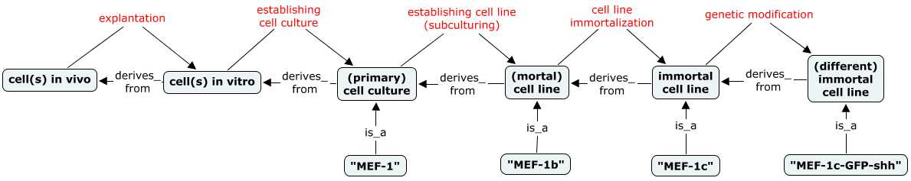

Consensus So Far . . .
a b c d e
A cell culture is a lineage of cultured cells tracing back to a single source that includes ALL passages of cells subsequent to the establishment of a cell culture (up to a point where the culture is modified in such a way as to establish a new cell culture or line)
A primary cell culture is a cell culture established directly from a fresh tissue source, which has not been passaged to become a cell
A cell line is a cell culture that has been passaged into a more homogenous/stable line
there is only one instance of each line above (e.g. MEF-1b, MEF-1c, MEF-1c-shh)
a new line is established at steps c, d, and e
Notes:
. . . . of what things exist and how they are related (may be easiest to start with our understanding of cell cultures and lines and move on to cells on next slide)
Cell culture has two exhaustive, disjoint subtypes: primary cell culture, cell line
Diagram shows inputs and outputs of processes from the explanation of a founder cell to the establishment and modification of immortal cell lines
Key points here to be sure wee all agree on:
is that a culture or line is a lineage
. . .
cell line = a collection of cultured cells tracing back to a single biological source that represents any and all subsequent passages of cells following the establishment of the line, up to a point where it is modified in such a way as to establish a new cell line.

Slide 4
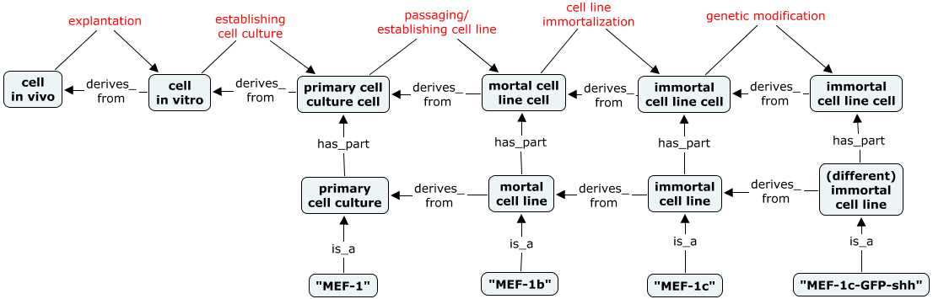
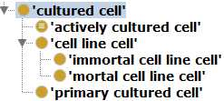
Consensus So Far . . .
a b c d e
A given cultured cell or cell line cell can be part of only one cell culture or cell line (because all cell cultures and lines have disjoint/mutually exclusive member cells)
For example, when a primary culture is passaged a new ‘cell line’ is created, and all cells output from this passage are no longer members of the old primary culture (which may continue to exist)
Even a single isolated cell line cell is necessarily part_of a cell line (since a cell line includes all cells derived from its establishment, independent of their being physically co-located )
Notes:
Cells enter the picture as parts of cell cultures and lines. Trivially, cells are inputs/outputs of the same processes as their collections.
Again, some key points to recognize and agree on are that . . .
cell culture and cell line cells are necessarily cultured cells (to clarify, being cultured is different than having been passaged).
cell line cells

Slide 5
Review Class Definitions and Labels
https://docs.google.com/spreadsheet/ccc?key=0AiKzIoedGeqJdEkwd2Q1aFJPTHR5d0U5VUpkekJ3b1E#gid=0

Slide 6
Class Definitions: Challenges
https://docs.google.com/spreadsheet/ccc?key=0AiKzIoedGeqJdEkwd2Q1aFJPTHR5d0U5VUpkekJ3b1E#gid=0
1. Defining a ‘cell line’ has been particularly challenging (as evidenced by lively debate)
When is a new cell line established?
When does a primary culture become a cell line?
first passage? Xth passage? some non-passage criteria?
What experimental modifications of existing lines create a new line?
selection? immortalization? other genetic modifications?
Notes:
Do we want to be precise and specify that a single passage creates a line form a primary culture. Or be less precise to allow application of different criteria in different situations

Slide 7
Class Definitions: Challenges
https://docs.google.com/spreadsheet/ccc?key=0AiKzIoedGeqJdEkwd2Q1aFJPTHR5d0U5VUpkekJ3b1E#gid=0
2. Can a single founding cell qualify as a cell culture or line?
If yes, this single cell, once cultured, would be considered a cell culture or line.
If no, when is a new culture or line established? At first division?
Emerging consensus is yes. Consequences of this include assertion of ‘cell culture’ and ‘cell line’ as material entities (vs object aggregates), and their single cell parts being defined using ‘has grain’ rather than ‘has member’

Slide 8

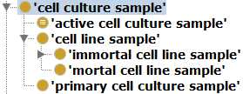
Review Consensus Model in OBI
Three hierarchies that represent different ‘populations’ of cells that are relevant in different contexts of experimental biology
1. A single ‘cultured cell’
review for implementation in CLO (requirements met?)
2. A ‘cell culture’ or ‘cell line’ as an entire lineage of cells
review for keeping in OBI
3. A ‘cell culture sample’ as an applied portion of a cell culture/line
also to be live in OBI
Notes:
Accommodates all aspects of model discussed so far
Aims to meet needs of OBI, CLO, ERO, ReO, . . .
Includes modeling that will eventually live elsewhere (CLO, ERO?)

Slide 9

Cell Culture Samples (OBI)
Cell culture samples are collections of cells that represent a defined portion of a cell culture that has been continuously maintained together in culture (or has been removed from such a culture for storage or experimental application)
Definitional criteria clearly demarcate a useful collection of cells in a sample, which represents what researchers actually culture, experiment on, and share.
Will be a relatively uniform population (similar evolution/genetic drifts due to continuous co-culture)
All cells necessarily output from a single subculture or storage split . . .
and necessarily have the same passage number
Notes:
Every cultured cell is part_of some cell culture
because a cultured cell does not exist until a culture is established
A cell culture sample necessarily has_part some cultured cell . . . but a cultured cell is not necessarily part of a cell culture sample
e.g. a single, isolated cultured cell is part of a cell culture, but not a cell culture sample
Other possible ways to demarcate what comprises a sample:
all cells of a line at a particular passage number? generation number? (will exist across different locations and times)
all cells of a line in a single lab?
all cells of a line in a single dish/container?
no demarcation rules at all (any conceivable portion of a given line)
other possibly useful ways for defining what constitutes a sample?

Slide 10



Cell Culture Related Processes (OBI)
Modeling of processes related to culturing cells and establishing / modifying cell lines
1. OBI:‘establishing cell culture’ process hierarchy – a work in progress
CLO:‘cell culturing’ hierarchy – to be aligned with OBI: ‘maintaining cell culture’
CLO:‘cell line modification’ classes – to be modeled in OBI as well

Slide 11
‘Active’ Culture Classes for CLO
Are ‘actively cultured cell’/’active cell culture’ defined classes sufficient for what CLO needs?
‘actively cultured cell’ = a cultured cell that is actively being propagated or maintained in culture medium
’active cell culture sample’ = a cell culture sample that is actively being maintained or propagated in vitro
(does not include media)
Does CLO need a class representing cells plus media?

Slide 12
Recap and Moving Forward
Does ‘cultured cell’ model meet CLO requirements?
Implement in CLO (or CL?) and OBI will MIREOT back
Does ‘cell culture’ and ‘cell culture sample’ modeling work for all?
Will live in OBI and CLO can import what it needs.
How fit with Oliver’s ‘cell line generation’ and ‘cell line cell population’
Utility of ‘cell culture/line’ representation in addition to samples?
Are ‘actively cultured cell’/’active cell culture’ classes good for CLO?
Need for a class representing cells plus media?
Are cultured cells ‘experimentally modified’?
Punt for now and assert as types of CL:’cell in vitro’
Culturing processes also to live in OBI and be imported by CLO
more work needed here
Notes:
Label may depend on how we define this class (or classes)
cell line sample, portion, generation,
cell line cell population (Oliver)
and do we really need a class representing a culture including media? what is the need for this? Will likely leave this to CLO to implement If they need it (OBI no want a possible fourth duplication of cell line hierarchy)
we can link actively cultured cells to media and culture conditions through the maintaining cell culture process (ie actively cultured cells participate in some maintaining cell culture that has specified input some media type, or realizes some conditional specifications (O2 concentration,. temperature)

